Slide 1

Math Core Subtests on the KTEA 3
Denise DeLoria, Elementary SPED Instructional Coach
Denise_deloria@chino.k12.ca.us
Teresa Lackey, Secondary SPED Instructional Coach
Teresa_lackey@chino.k12.ca.us
Notes:
In this section of Special Education Assessments we are going to be looking at the Math Core Subtests

Slide 2
Learn
Learning Outcomes
For the subtests:
Math Concepts and Application
Math Computations
How to identify the Basal and Ceiling
How to Score the subtests
Notes:
We are going to look at the math computation subtest along with the math concepts and applications subtest. We will look at how to identify the basal and the ceiling and how to score the subtests.

Slide 3
Core Composites & Subtests
Reading:
Letter & Word Recognition
Reading Comprehension
Academic Skills Battery
Math:
Math Concepts & Application
Math Computations
Written Language:
Written Expression
Spelling
Notes:
These are the 6 subtests that make up the core composites. Under math you will find math concepts and application along with math computations.

Slide 4



KTEA-3 Record Form
Used for scoring
Can be Form B or Form A (blue)
Notes:
This is the record form. It will be used to score all your subtests.

Slide 5
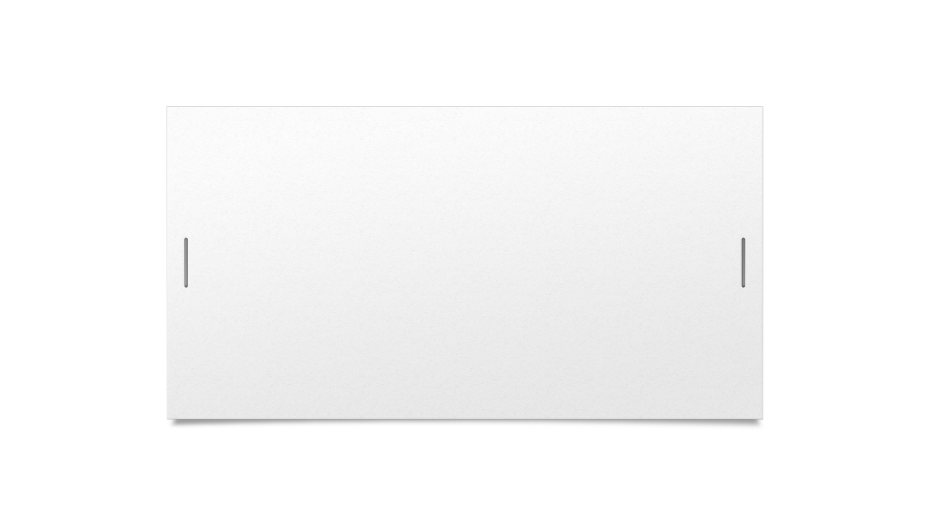


Math Concepts and Applications
This Photo by Unknown Author is licensed under CC BY-SA
Notes:
Let’s look at math concepts and applications

Slide 6
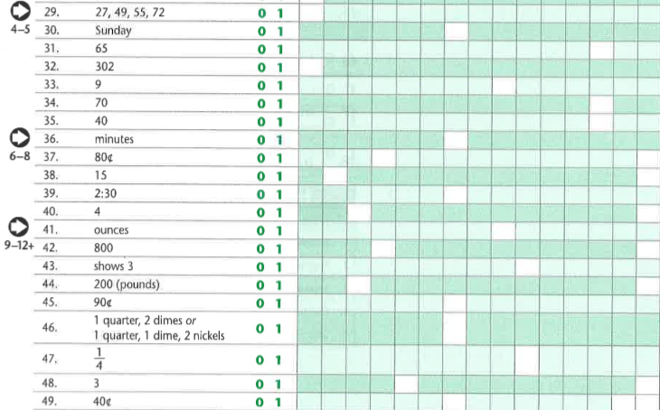
Notes:
The examiner will choose a start point depending on the grade of the student. Once you have chosen the start point turn to page 43 in the stimulus book. The student can use a piece of scratch paper if they need it. Here is where you will read the questions to the student. Once the student has completed the test you will add up the correct responses to get the raw score.

Slide 7
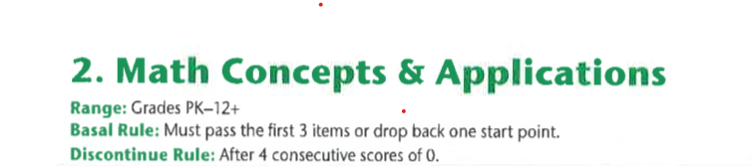
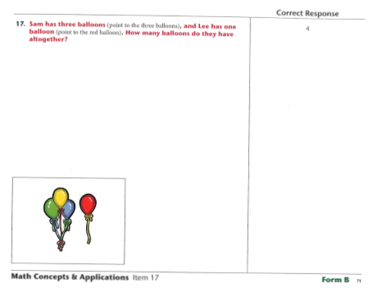
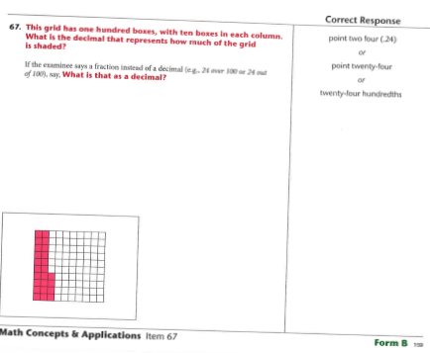
Notes:
The basal rule states that the first 3 items must be passed or you should drop back one start point. The discontinue rule states that when the student has earned 4 consecutive scores of 0 you need to stop. When counting the correct responses give credit for all items preceding the basal.

Slide 8
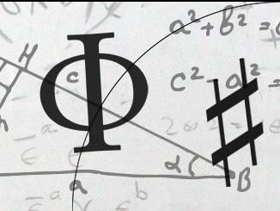
Math Computation
This Photo by Unknown Author is licensed under CC BY-NC-ND
Notes:
Now let’s look at math computation

Slide 9
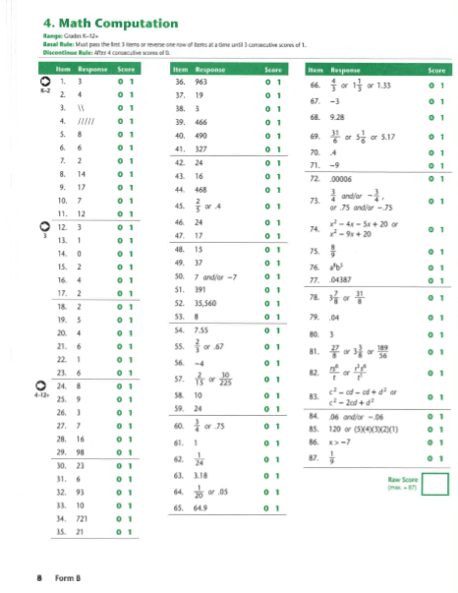
Notes:
This page is found in the Record Form booklet on page 8. This is where you will record the student’s scores and add up the raw score.

Slide 10
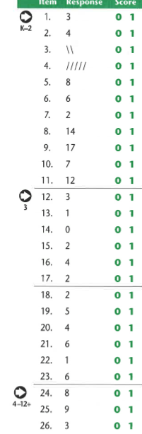
Notes:
Choose the start point based on the student grade level.

Slide 11
KTEA-3 Response Booklet
This will be used with only the tests listed on the front.
Students write in this booklet
Notes:
For the math computation you will have the student use this response booklet to record his or her responses. The subtest begins on page 3.

Slide 12
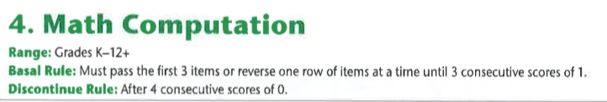
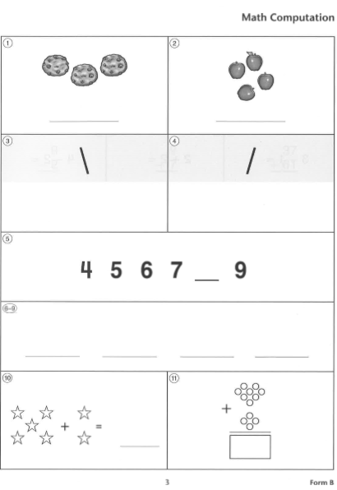
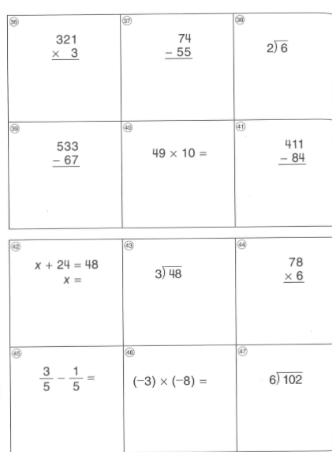
Notes:
The basal rule states that the student must pass the first 3 items or you will need to have him reverse one row until he does get 3 consecutive problems correct. While the discontinue rule state that after 4 wrong answers in a row stop. When adding up the raw score give credit to all the items preceding the basal. But do not give credit for correct answers past the 4th incorrect answer.

Slide 13

denise_deloria@chino.k12.ca.us
Elementary Special Education Instructional Coach
teresa_lackey@chino.k12.ca.us
Secondary Special Education Instructional Coach
Notes:
Thank you for your time and please feel free to contact either one of us if you have any questions or concerns.

